Slide 1
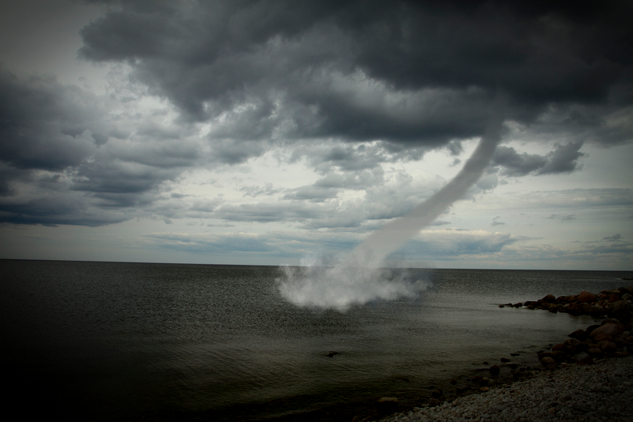
By the blast of your nostrils the waters were piled up, the flowing water stood upright like a heap, and the deep waters were solidified in the heart of the sea.
Exodus 15:8 (NET)
© 2017 www.clipart.com

Slide 2
By the blast of your nostrils the waters were piled up, the flowing water stood upright like a heap, and the deep waters were solidified in the heart of the sea.
Exodus 15:8 (NET)
Moses stretched out his hand toward the sea, and the Lord drove the sea apart by a strong east wind all that night, and he made the sea into dry land, and the water was divided.
Exodus 14:21 (NET)

