Slide 1
Science and faith agree
Science and faith disagree

Slide 2
Science and faith agree
Science and faith disagree
People of faith have
varying views
Scientists have
varying views

Slide 3
Science and faith agree
Science and faith disagree
People of faith have varying views
Scientists have varying views
Faith and science once agreed but views have changed
Faith and science once disagreed but views have changed
People of faith once had the same view but now have varying views
People of faith once had varying views but now have the same view

Slide 4
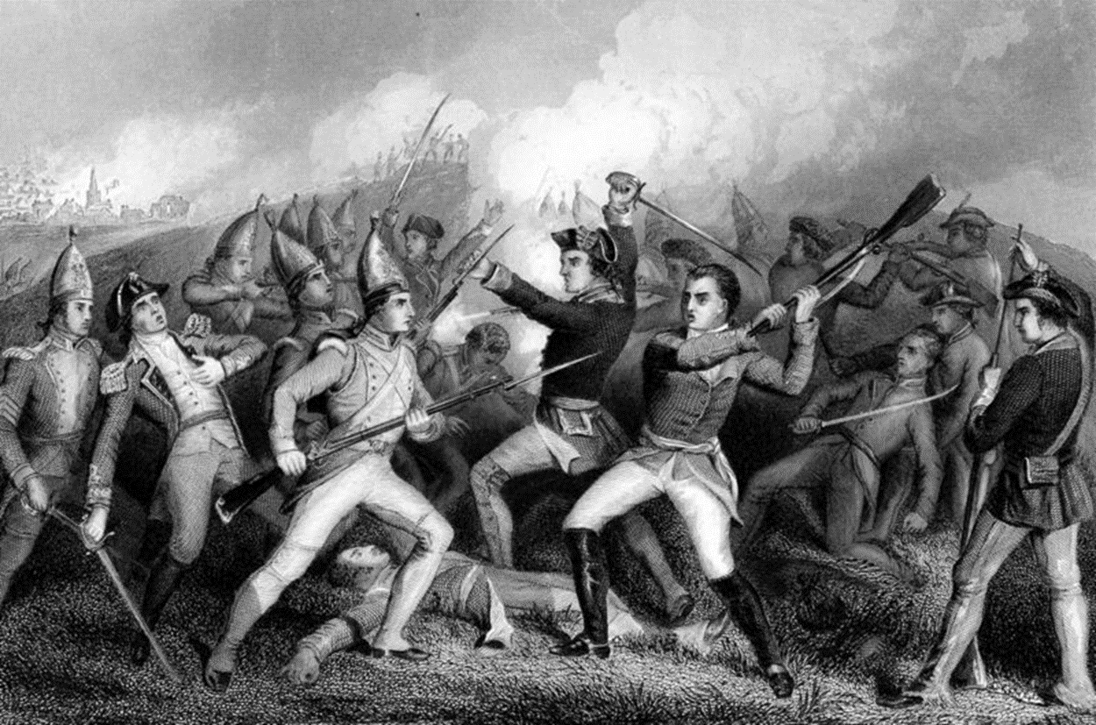
Faith versus Science?

